Slide 1
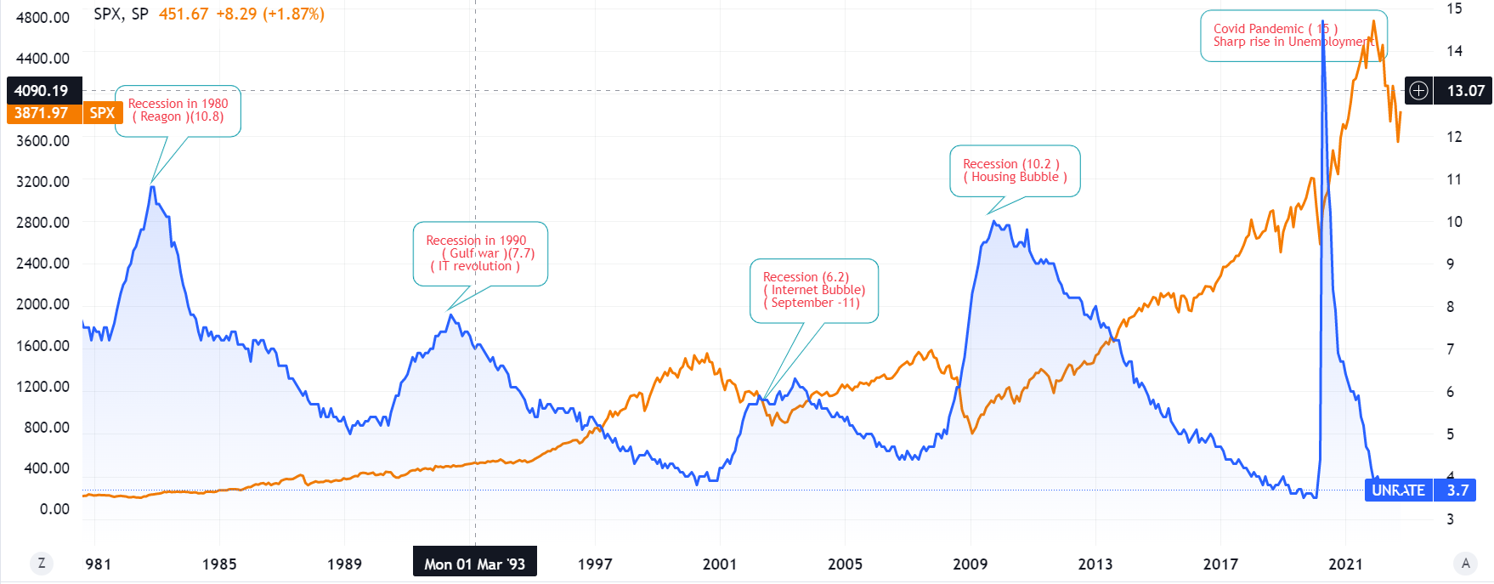
Unemployment Data and S&P 500

Slide 2
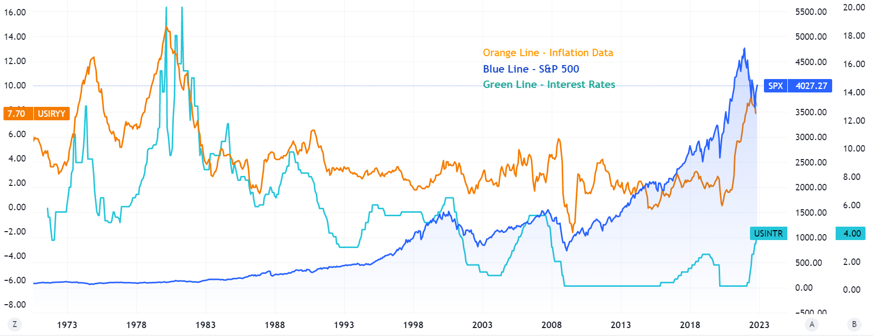
Inflation Data and S&P 500

Slide 3
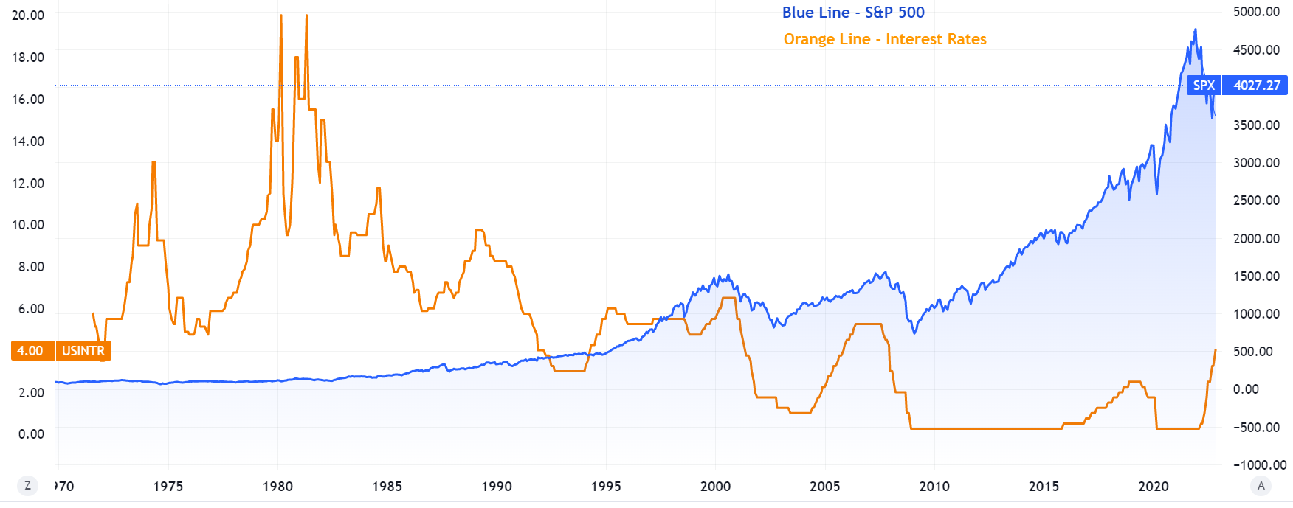
Interest Rate Data and S&P 500

Slide 4
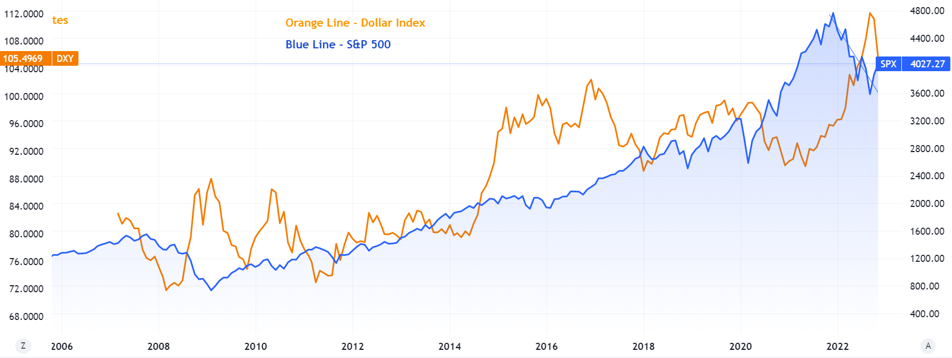
Dollar Index and S&P 500

Slide 5
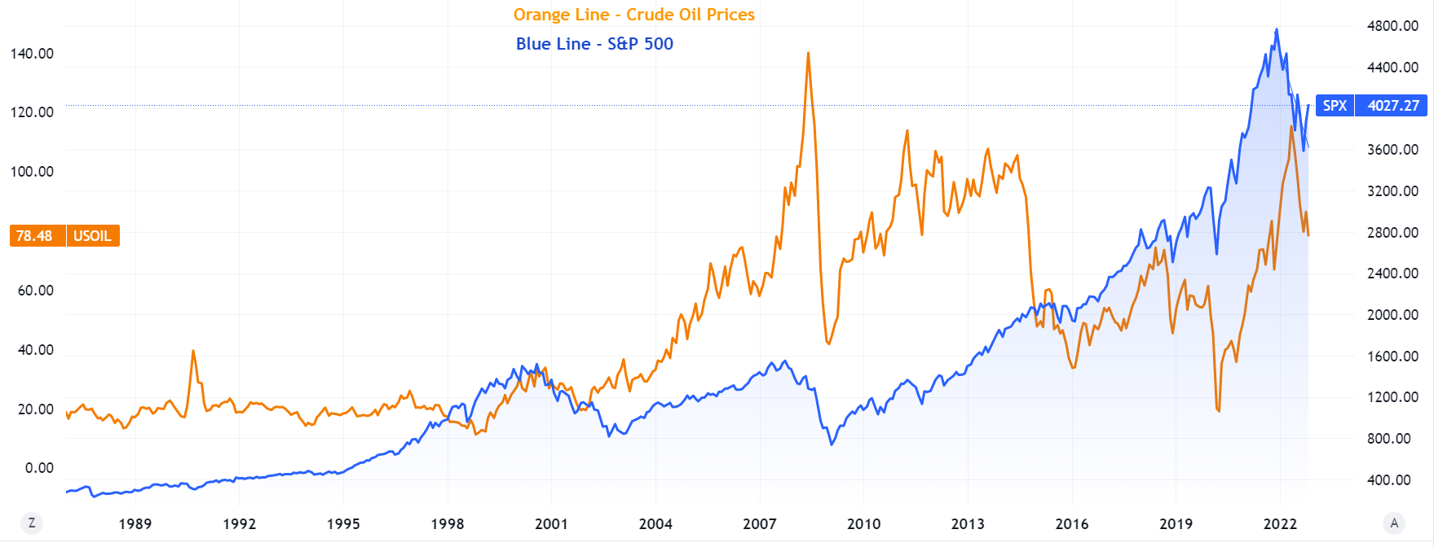
Crude Oil and S&P 500

Slide 6
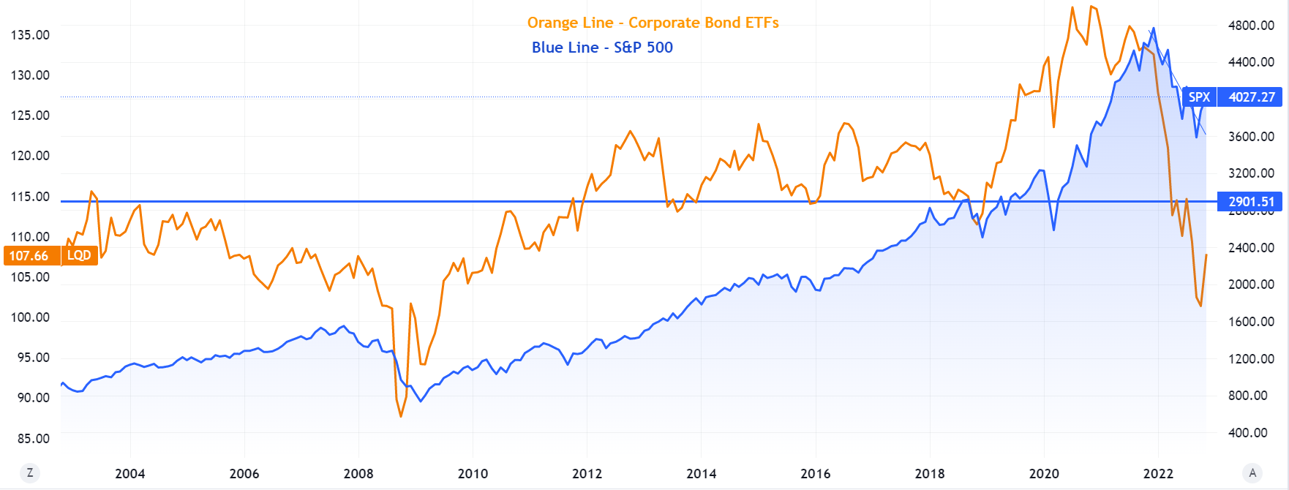
Bond Yield and S&P 500

Slide 7
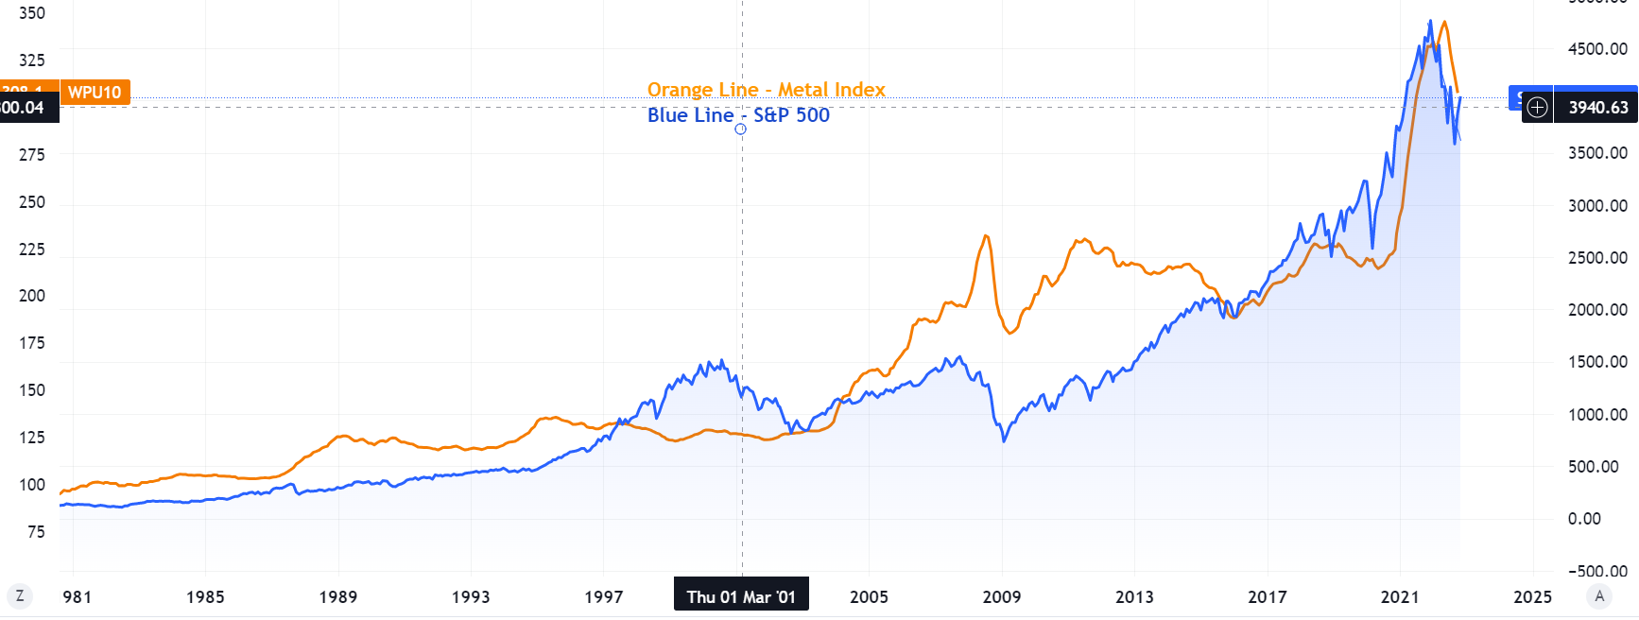
Metal Index and S&P 500

